Slide 1
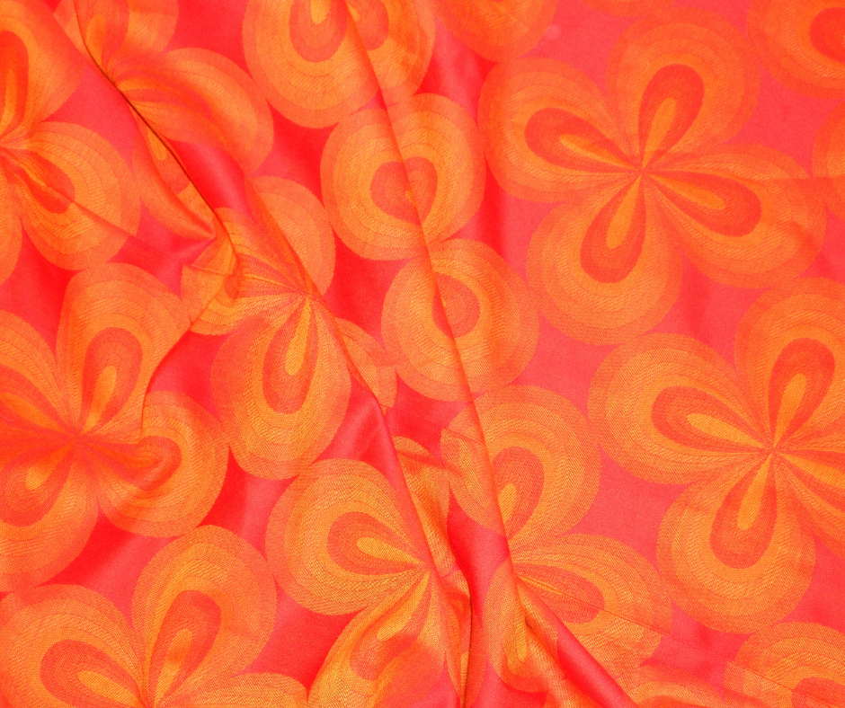
Here’s a look at our live auction items!

Slide 2
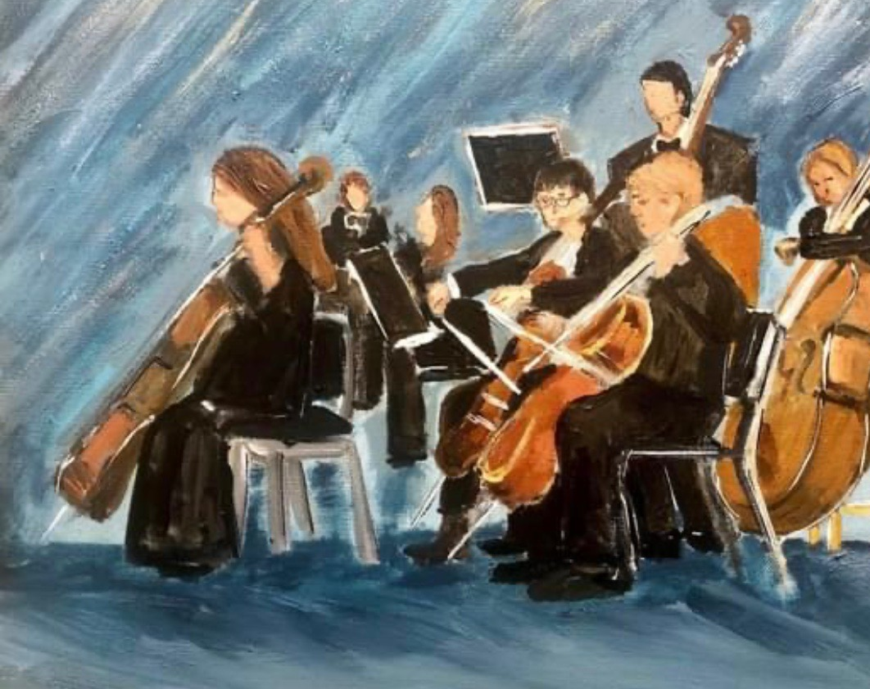
“Symphony” Original Art by Vivian Noe 16”x 20” mixed-media painting Value $1200

Slide 3
18” pearl necklace 11-12 mm pearls with a sterling silver clasp
Total value $395
Donated by
Sissy’s Log Cabin

Slide 4
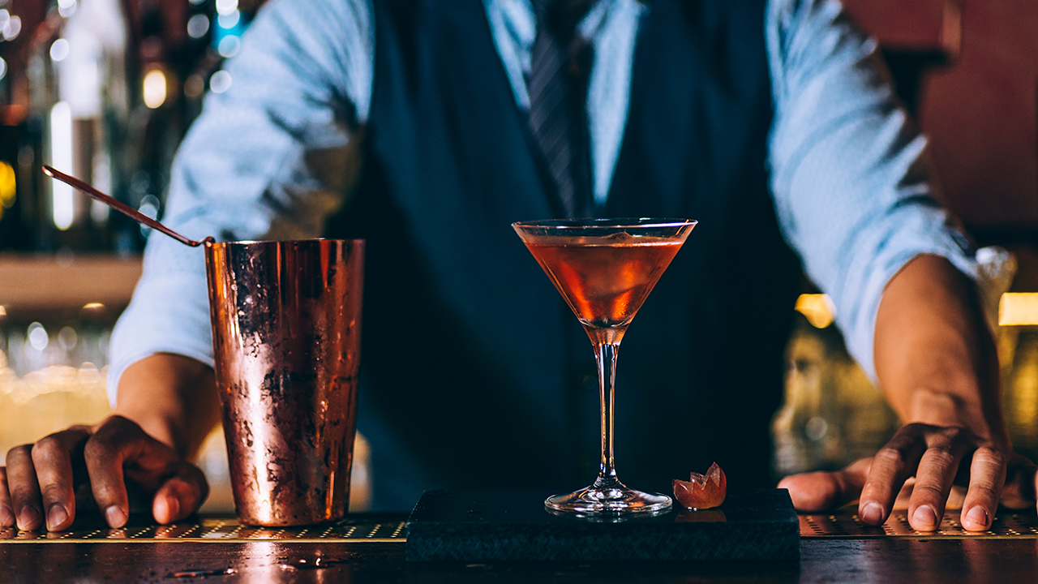
Stock the Bar! The CSO board offers their favorite libations for your complete, at-home bar Total value $530

Slide 5
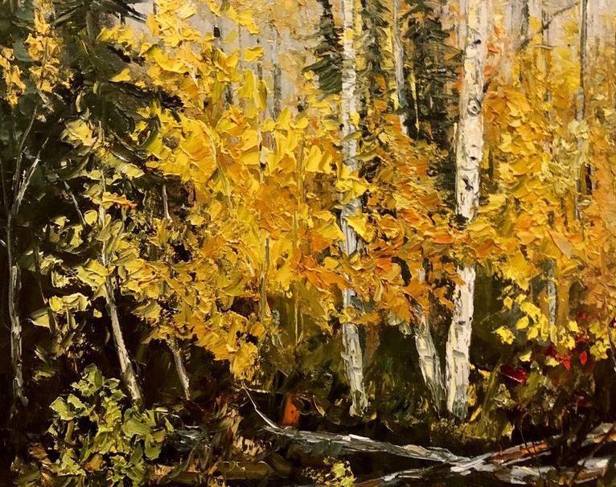
Live painting by artist, Steve Griffith Value $2500

Slide 6
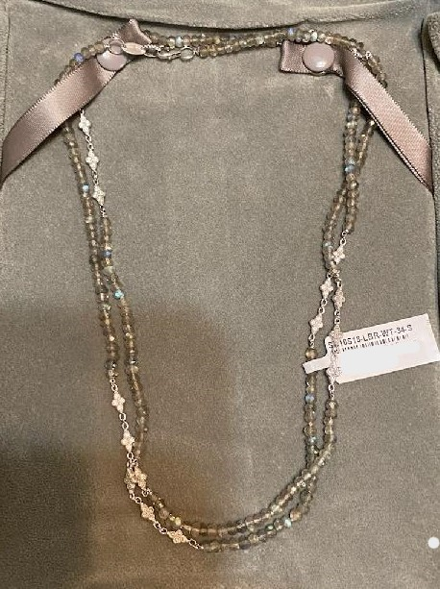
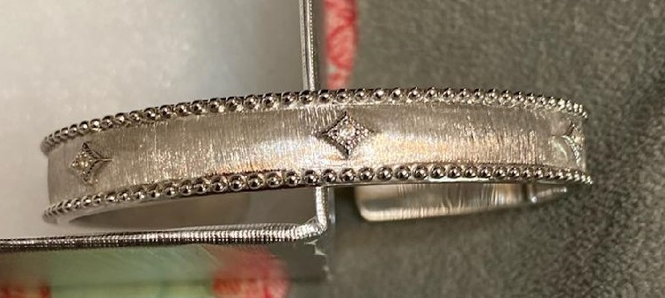
Jude Francis
Gray Labradorite and White Topaz 34 “ necklace
Sterling Silver and White Topaz bracelet
Total Value $1500
Donated by

Slide 7
Fort Walton Beach Getaway Gulf Dunes 7 Night Stay, January 1, 2023-December 31, 2023

Slide 8
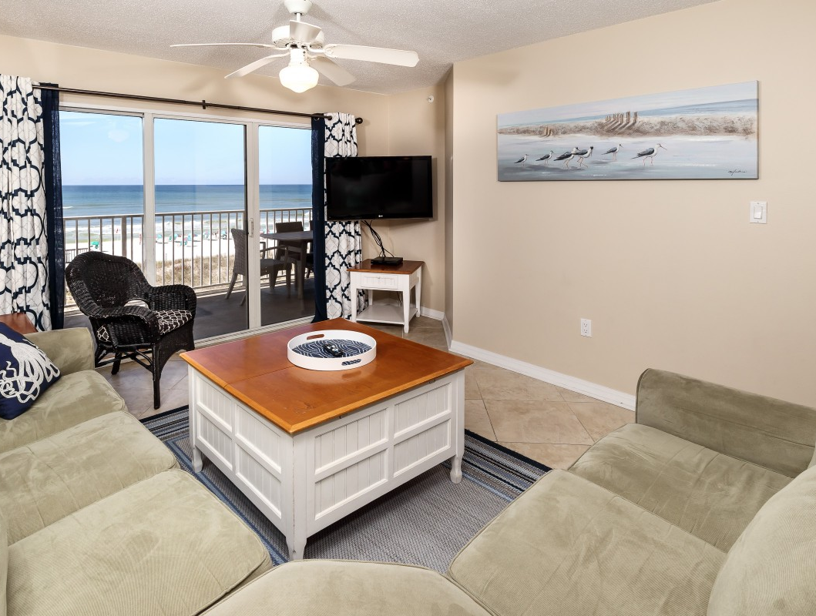
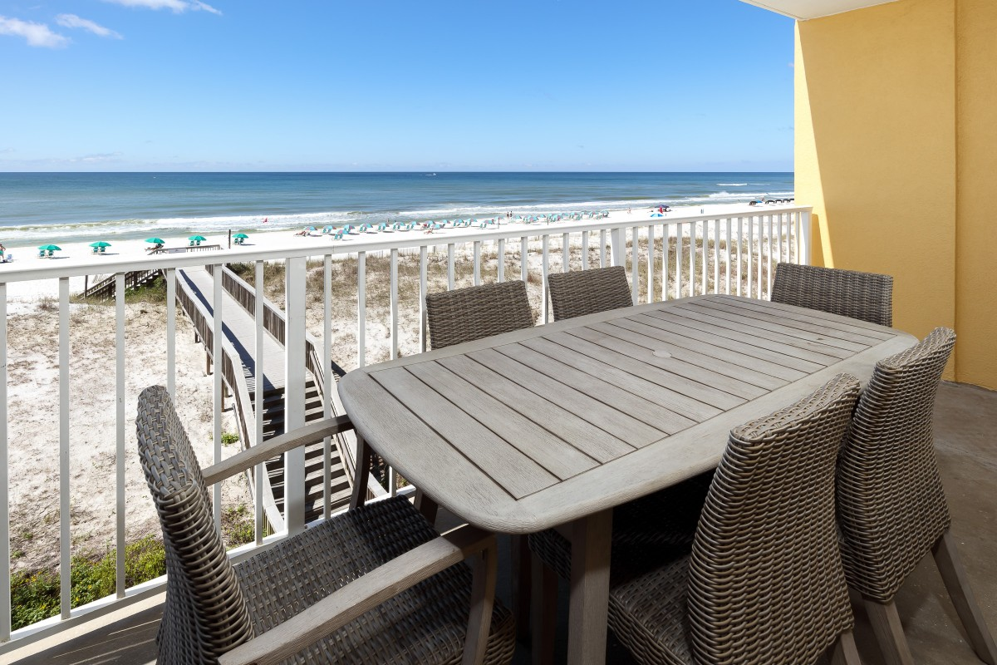
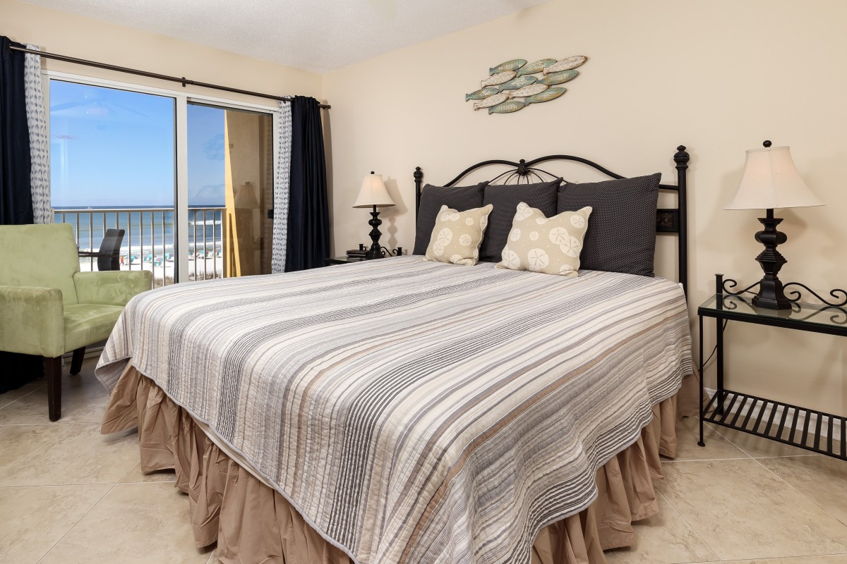
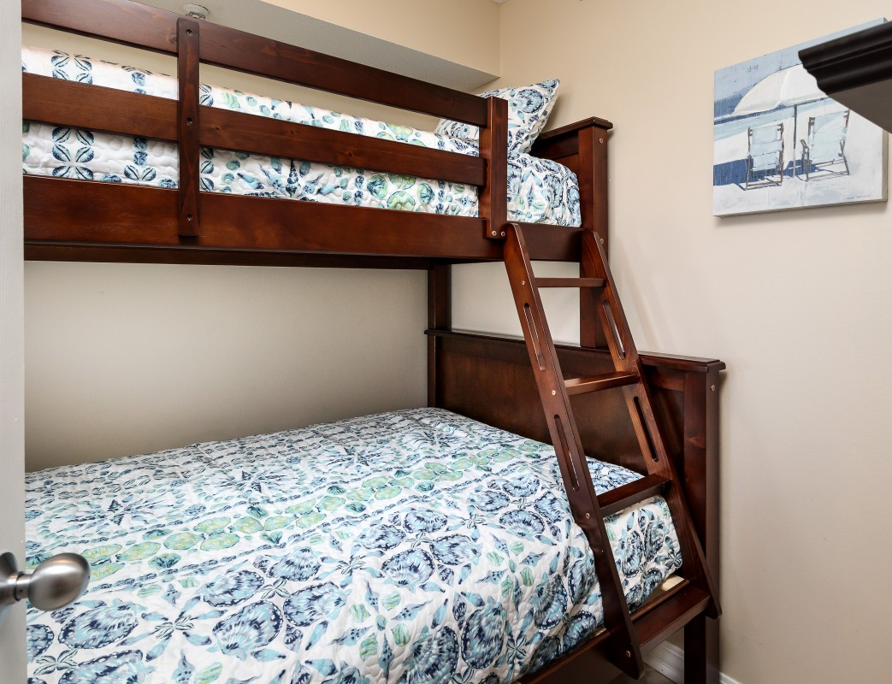
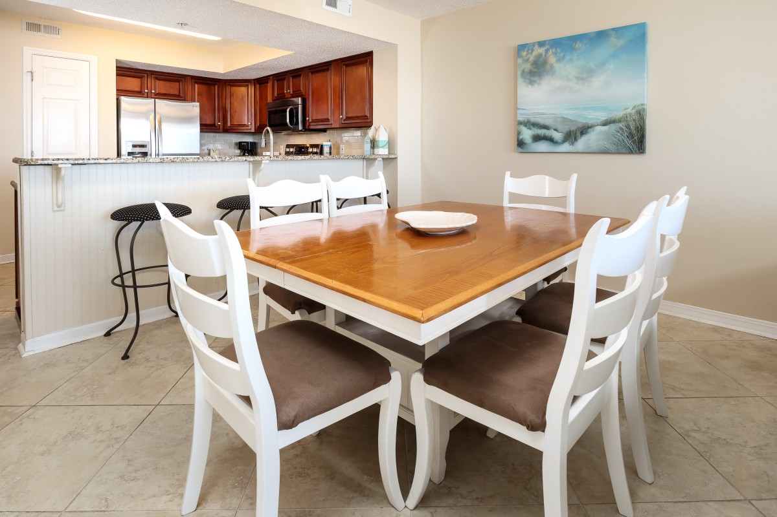
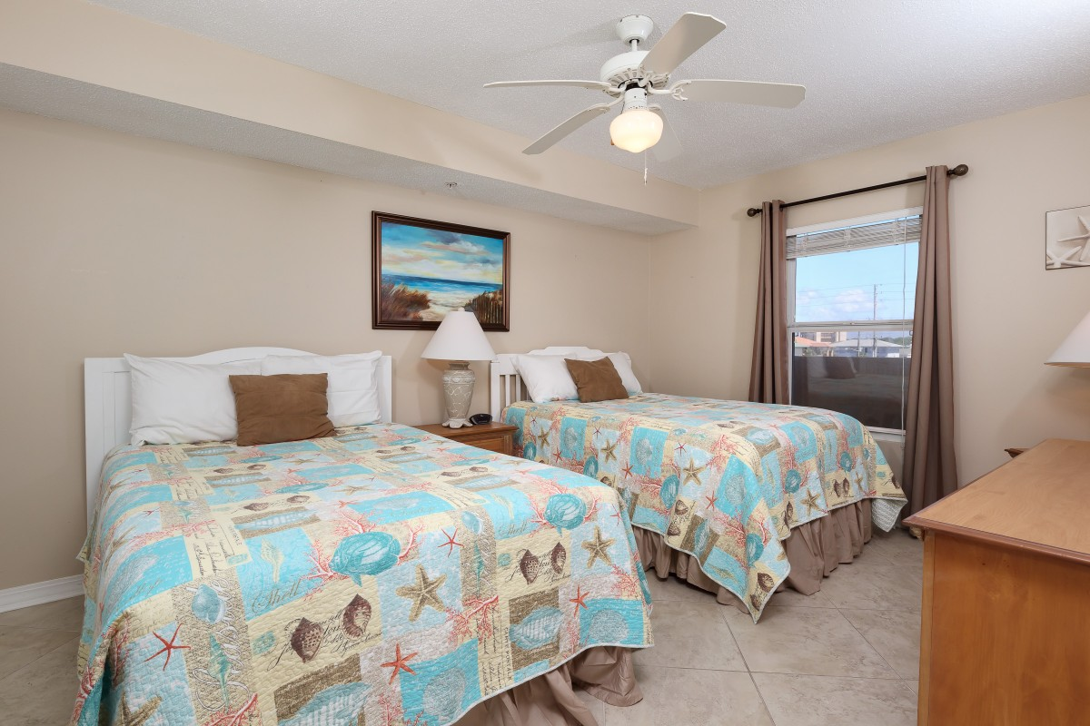

Slide 9
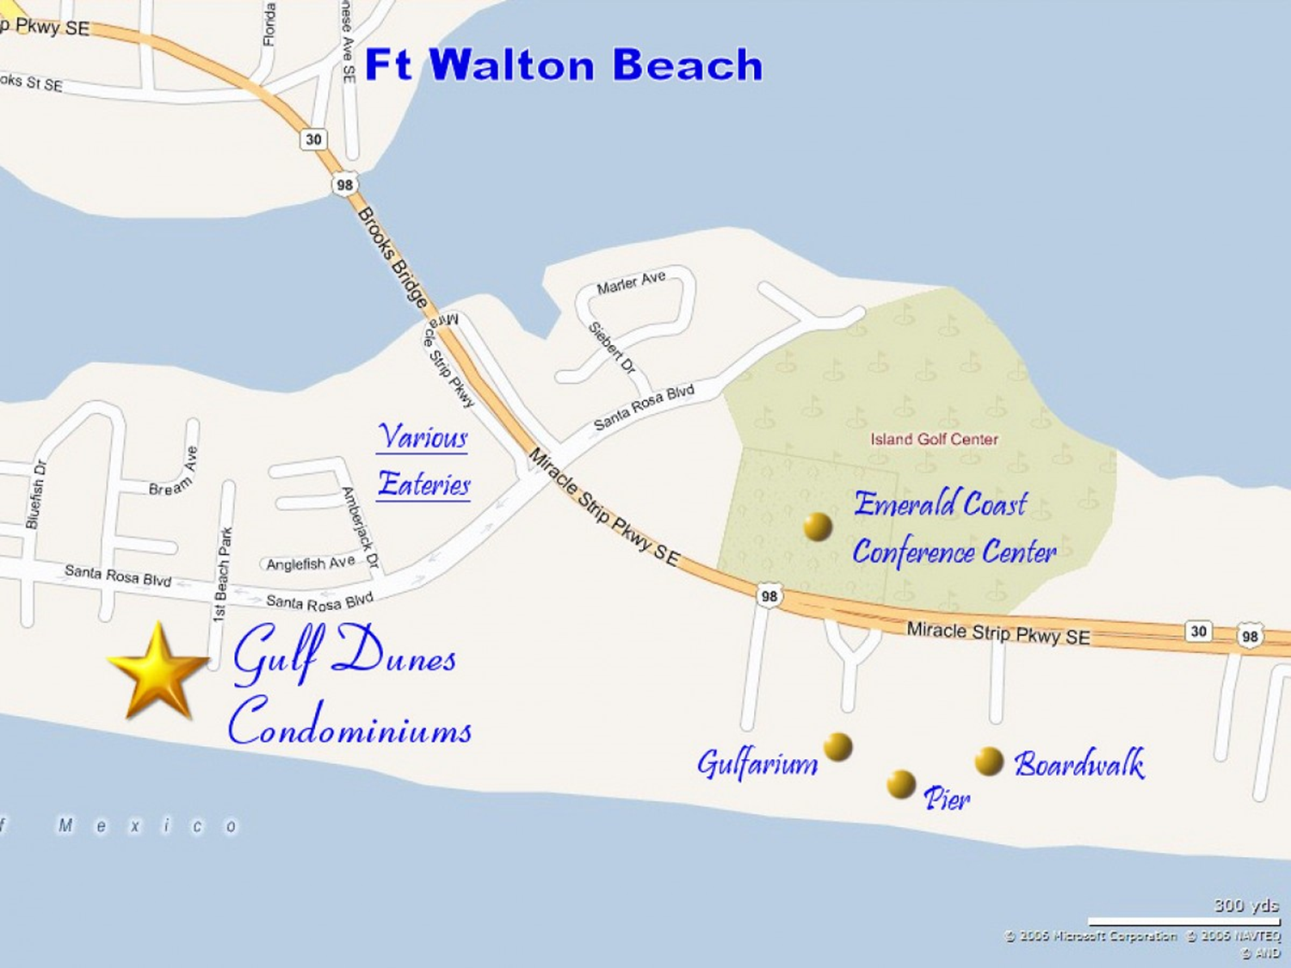
For complete property information go to
https://www.emeraldcoastrentals.com/vacation-rentals/rental/1207-54189/

